Slide 1

Module 2
Building a
Point of
View

Slide 2
Building a POV
Review

Slide 3
Last time we covered how
We all have common human experience
But an Ultimate Authority
Which drives our Point of View of reality
Which determines what we think
is fact or fiction, believable or unbelievable

Slide 4
Building a POV
Review
The knowledge flowchart

Slide 5
Knowledge Flowchart
Basic Assumptions (common experience)
  |(induction, sense perception)
Ultimate Assumption + Authority (God or self)
|(determines our Point of View)
Point of View
|(contain a web of beliefs)
Beliefs
|(used to determine...)
Facts/Evidence/Proof/Truth
|(Is where many people incorrectly start)
Notes:
The closer to the top you are, the more basic
your assumptions are
The further to the bottom you are,
the more assumptions you have
which are built on top of one another

Slide 6
Building a POV
Review
The knowledge flowchart
Why talk about POVs?

Slide 7

Why do we oppose non-Christian POVs?

Slide 8
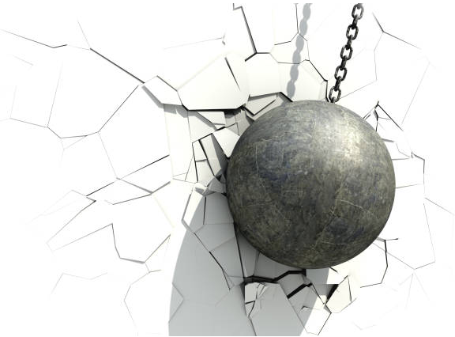
"We destroy arguments and every lofty opinion raised against the knowledge of God and take every thought captive to obey Christ“. - 2 Corinthians 10:5
-We worship the Creator, not the creation.
-The creation is not the source of knowledge
And truth
Jesus is the way
the truth
and the life
(John 14:6)
We care
about truth

Slide 9
Building a POV
Review
The knowledge flowchart
Why talk about POVs?
How do we demolish false POVs?

Slide 10
What tactic do we use?
to demolish
POVs which are opposed
to the Christian God?

Slide 11
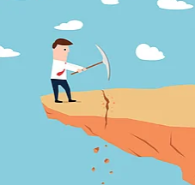
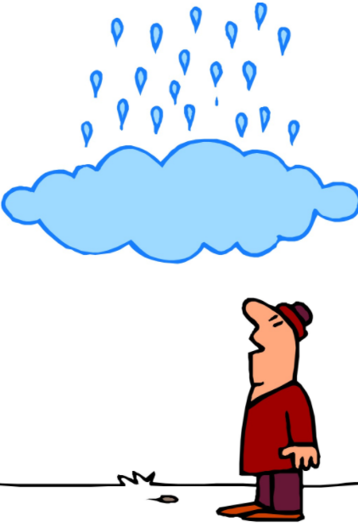
We reduce the POV
to absurdity
By demonstrating
its impossibility/irrationality
We show why
by their own
standards,
their POV
can't be true

Slide 12
There is a difference between
Saying
  You're wrong because
  the Christian POV says so
  And You're wrong because
  your own POV say so

Slide 13
Building a POV
Review
The knowledge flowchart
Why talk about POVs?
How do we demolish false POVs?
What are our targets?

Slide 14
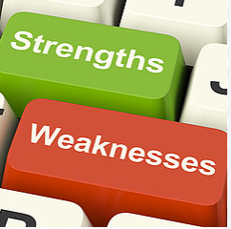
Target the 3 main pillars of POVs
We will show
How to identify
weaknesses

Slide 15
Building a POV
What are our targets?
  Pillar 1 - Coherence

Slide 16
3 pillars of a rational POV
Coherence
(not self-contradictory)
Explanatory power
(explains our world and the nature of humans)
Justification Force
(Good reason to believe it)
If any of these fail,
a POV will crumble under its own weight!
Notes:
There are 3 main pillars to critquing a POV.
Let's go through Justification.
Explanatory power:
-Not unicorn (no justification)
Justification Force:
-"I don't like it" is not a justification.
Does "I don't like it"
provide the possibility
of logic, human dignity, and moral 'oughts'?

Slide 17

Everyone has beliefs
  We test whether those beliefs
  are consistent with their POV
A rational POV
  should not contradict itself
If you contradict yourself
  You are not being rational
Only those in the Christian POV have the ability to live consistent with their POV

Slide 18
An Example
Islam believes Jesus was a prophet of God,
but was not God.
But Jesus said He is God.
Jesus cannot be a prophet of God
IF
he said he is God when his is not
Contradiction:
Jesus cannot be both claim to be God
and
not claim to be God at the same time.

Slide 19
Building a POV
What are our targets?
  Pillar 1 – Coherence
  Pillar 2 – Explanatory Power

Slide 20
3 pillars of a
POV
Coherence
(not self-contradictory)
Explanatory power
(explains our world and the nature of humans)
Justification Force
(Good reason to believe it)
Notes:
There are 3 main pillars to critquing a POV.
Let's go through Justification.
Explanatory power:
-Not unicorn (no justification)
Justification Force:
-"I don't like it" is not a justification.
Does "I don't like it"
provide the possibility
of logic, human dignity, and moral 'oughts'?

Slide 21

Example: If someone says
A pink pixie made the universe.
It has "explanatory power" but...
Does that mean there is
a good reason to believe it?
  That's called 'justification'
Human behavior is best explained by the Christian POV,
not a pink pixie
– see Romans 1 (more on that later)

Slide 22
Building a POV
What are our targets?
  Pillar 1 – Coherence
  Pillar 2 – Explanatory Power
  Pillar 3 – Justification Power

Slide 23
3 pillars of a
POV
Coherence
(not self-contradictory)
Explanatory power
(explains our world and the nature of humans)
Justification Force
(Good reason to believe it)
Notes:
There are 3 main pillars to critquing a POV.
Let's go through Justification.
Explanatory power:
-Not unicorn (no justification)
Justification Force:
-"I don't like it" is not a justification.
Does "I don't like it"
provide the possibility
of logic, human dignity, and moral 'oughts'?

Slide 24
Justification for a belief
Must have a good reason for the belief
  Are the beliefs related?

Slide 25
To have a good reason to hold a belief
Ask
Does one have anything to do
with the other?
Does the "then" follow the "if"?
  “If this, then that”.
Here are 2 examples...

Slide 26

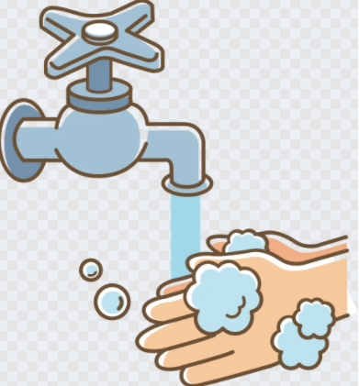


Most people believe the American slave trade was wrong and you should wash your hands after using the bathroom.
Most may agree with both.
But they aren't related at all!
Not true just because we agree.
"What if I told you washing my hands after using the restroom makes my Bitcoin investments go up“
-it's not a good reason for that belief

Slide 27
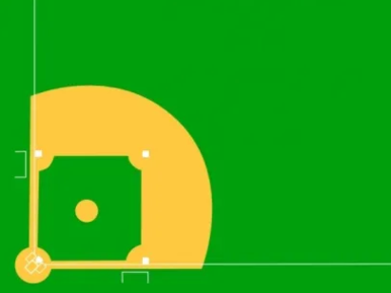
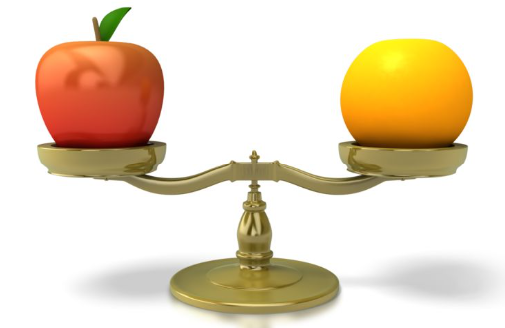
Another way to think of it
Those ideas weren't even
In the same ballpark
OR
Comparing
  Apples
  To Oranges

Slide 28
What you will notice
Is that the reason people hold beliefs
Is because they are following their Ultimate Authority

Slide 29
Do I like it?
Unbeliever logic with himself as the Ultimate Authority works like this:
  I like it, therefore it is true
  I dislike it, therefore it is false
  But the unbeliver will likely not be that open about it, or realize what he is doing
Just as NA slavery being wrong has nothing to do with washing your hands,
Our opinions have nothing to do with what is right or wrong, which can be demonstrated

Slide 30
Justification for a belief
Must have a good reason for the belief
  Are the beliefs related?
  Does the belief contradict your POV?

Slide 31
"I can be good without God"
How does your POV affect this claim?
Why does a materialist lack a good reason
to believe he can be good without God
based on his own POV?

Slide 32
Answers:
If God does not exist, "good" is a meaningless word
It then becomes only opinion.
An unchanging standard is assumed.
The unbeliever has no good reason to believe he ought to act in any certain way
That's from his own POV
If we are the descendants of pond scum,
then do we have any good reason to believe each individual human is the standard of good, even though humans disagree?

Slide 33
If someone holds a belief
That he
  has no good reason to hold (bitcoin example)
  contradicts his own POV (good without God)
Then it is
  He has no good reason to hold that belief
  Which is an un-justified belief

Slide 34
Justification for a belief
Must be rational
  Are the beliefs related?
  Does the belief contradict your POV?
Show your work
  It's not enough to agree
  Analyze the POV

Slide 35

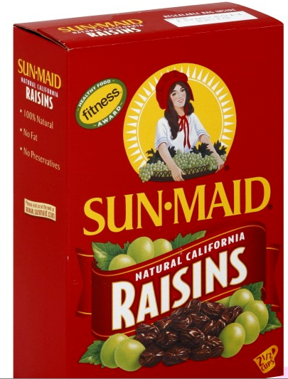
Justification for a belief
is not asking
“if”
you agree.
We want to know the reasons
for that belief.
Your POV contains
your reasons.
We want to see what caused you to
hold the belief
Notes:
The unbeliever loves, uses logic, math, and reason, but is unable to give a good reason, a justification to account for why he is able to do any of those

Slide 36
Example
You and the unbeliever agree that the NA slave trade was wrong
But why is it wrong according to
your POV?
Agreeing
And showing your work for your belief
Are not the same

Slide 37
Justification for a belief
Coherence
Explanatory Power
Justification
Conclusion

Slide 38
If a POV
Contradicts itself
Cannot explain our most basic assumptions
which form human experience
And has no good reason to believe it is true
Then we have identified an irrational POV
  If someone is ok with that,
  then they have no good reason
  to believe their POV is true

Slide 39
Here is another way to put it, for why we compare POVs...
A materialist will not hold beliefs which are consistent with his POV
Neither will the dualist
Neither will the polytheist
Nor will the non-Christian monotheist

Slide 40
Justification for a belief
Coherence
Explanatory Power
Justification
Conclusion
  How does this lesson relate to the next ones?

Slide 41

It's easy to say an egg stinks
But harder to lay your own
So far we have only
shown how to critique
other POVs
The unbeliever should then
at least consider that
Christianity may be true
We will eventually demonstrate why it is,
because of the impossibility of the contrary

Slide 42
Comprehension Questions
What are the 3 pillars of POVs
that we can measure them with,
to tell if they are rational?
Can anyone recall a "Justification" example?
Notes:
-presupposition: An assumption so basic that it cannot be supported by anything else
-myth: There are brute facts that you must agree to. We can use our authority of self, but you are not allowed to use your authority, the Christian God
-no
-they must be interpreted via basic assumptions
-crypto and washing hands
-authority – news soruce
-starting point determines where we end up
-An ultimate standard can only be justified by itself

Slide 43

3 ways to measure a POV
  Coherence (no self contradiction)
  Explanatory power
  Justification force (good reason)

Slide 44

Next Module:
The Myth of Neutrality
and Common Ground

Slide 45

End of Module 2
Questions?

